Slide 1
Optimizing 630 Jewelers’ Store Profits
By: Nathanael Ochoa

Slide 2
Introduction
Tasked with creating:
A Product Recommender System
An Inventory Management Model
Given a CSV file containing sales data from 12/01/2018 - 12/01/2021.
File contains 95,911 records and 13 columns.
The project was completed using the Python programming language and Jupyter Notebook.

Slide 3
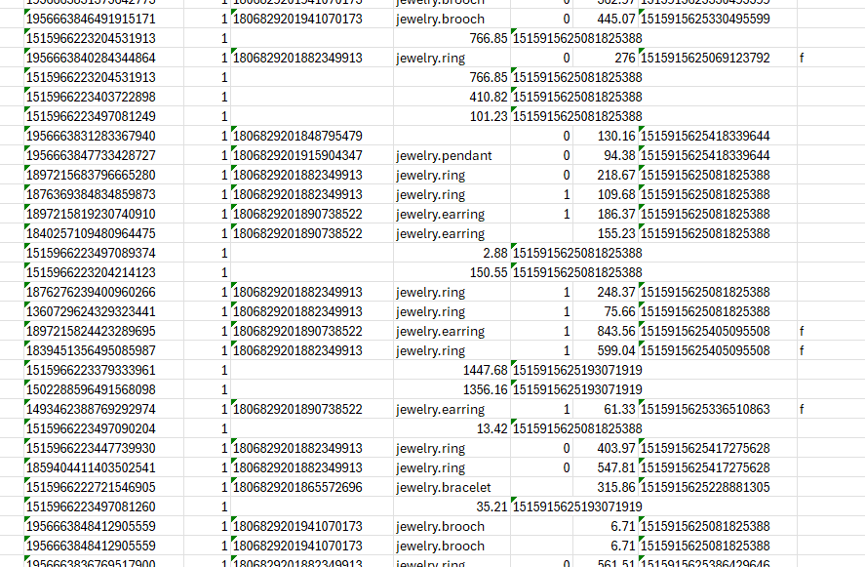
Data Preparation
Data contained null (empty) values.
Some data was misaligned.

Slide 4
Data Preparation - Handling Null Values
Any null values in the:
brand_id column were filled in with ‘-1’.
product_gender column were filled in with ‘u’.
main_gem column were filled in with ‘unknown-gem’.
After this task any rows containing empty cells were removed from the dataset altogether.
81.71% (78,391 records) of the original data remained.
All rows and cells contain a value.
Notes:
-1: unbranded
u: unisex
unknown-gem: possibly not have a gem but following already established syntax from the ‘main_color’ column (unknown-color).

Slide 5
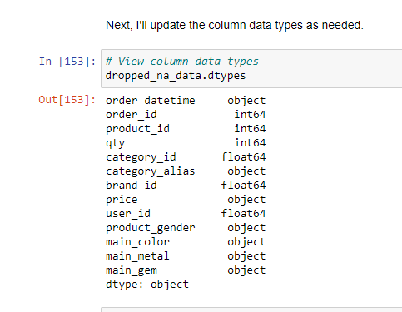
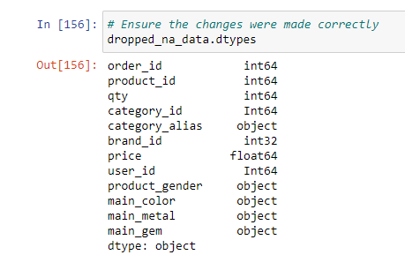
Data Preparation - Updating Column Data Types
Due to the null values many columns were uploaded as the incorrect data types.
For example, the category_id column only contains integer values but was uploaded as a floating point number (decimal).
Notes:
Before changes (left) and after changes (right)
Note that the ‘order_datetime’ column was converted into datetime format and set as the DataFrame’s index.

Slide 6
Product Recommender System - Content-Based Filtering
Recommends items similar to those a user has purchased based on item features.
Implementation steps:
One-Hot Encoding: Convert category_alias, product_gender, main_color, and main_metal columns into binary format to create a feature matrix.
Item Similarity Calculation: Use cosine similarity to measure the similarity between items based on feature vectors, providing a score from 0 (no similarity) to 1 (identical).
Recommendation Generation: Construct an item similarity matrix and aggregate scores for items not yet interacted with, based on similarity to previously purchased items.

Slide 7
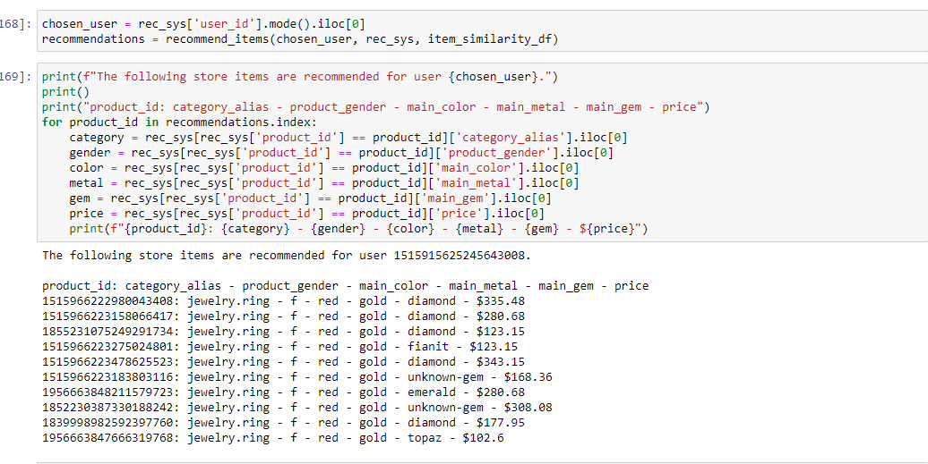
Product Recommender System - Results
The system recommends 10 items and lists each product_id and relevant features.
I used the user_id with the most items purchased.

Slide 8
Inventory Management - Exponential Smoothing
For this analysis, the product with the most occurrences in the data was used: a women’s ring.
Implementation Steps:
Group by Month and Product: Aggregate sales data by month and product to sum quantities.
Model Specification: Use Holt-Winters’ multiplicative seasonal method with Exponential Smoothing, specifying with a seasonal period of 12 months.
Generate Forecast: Forecast future dates for a period of 12 months.

Slide 9
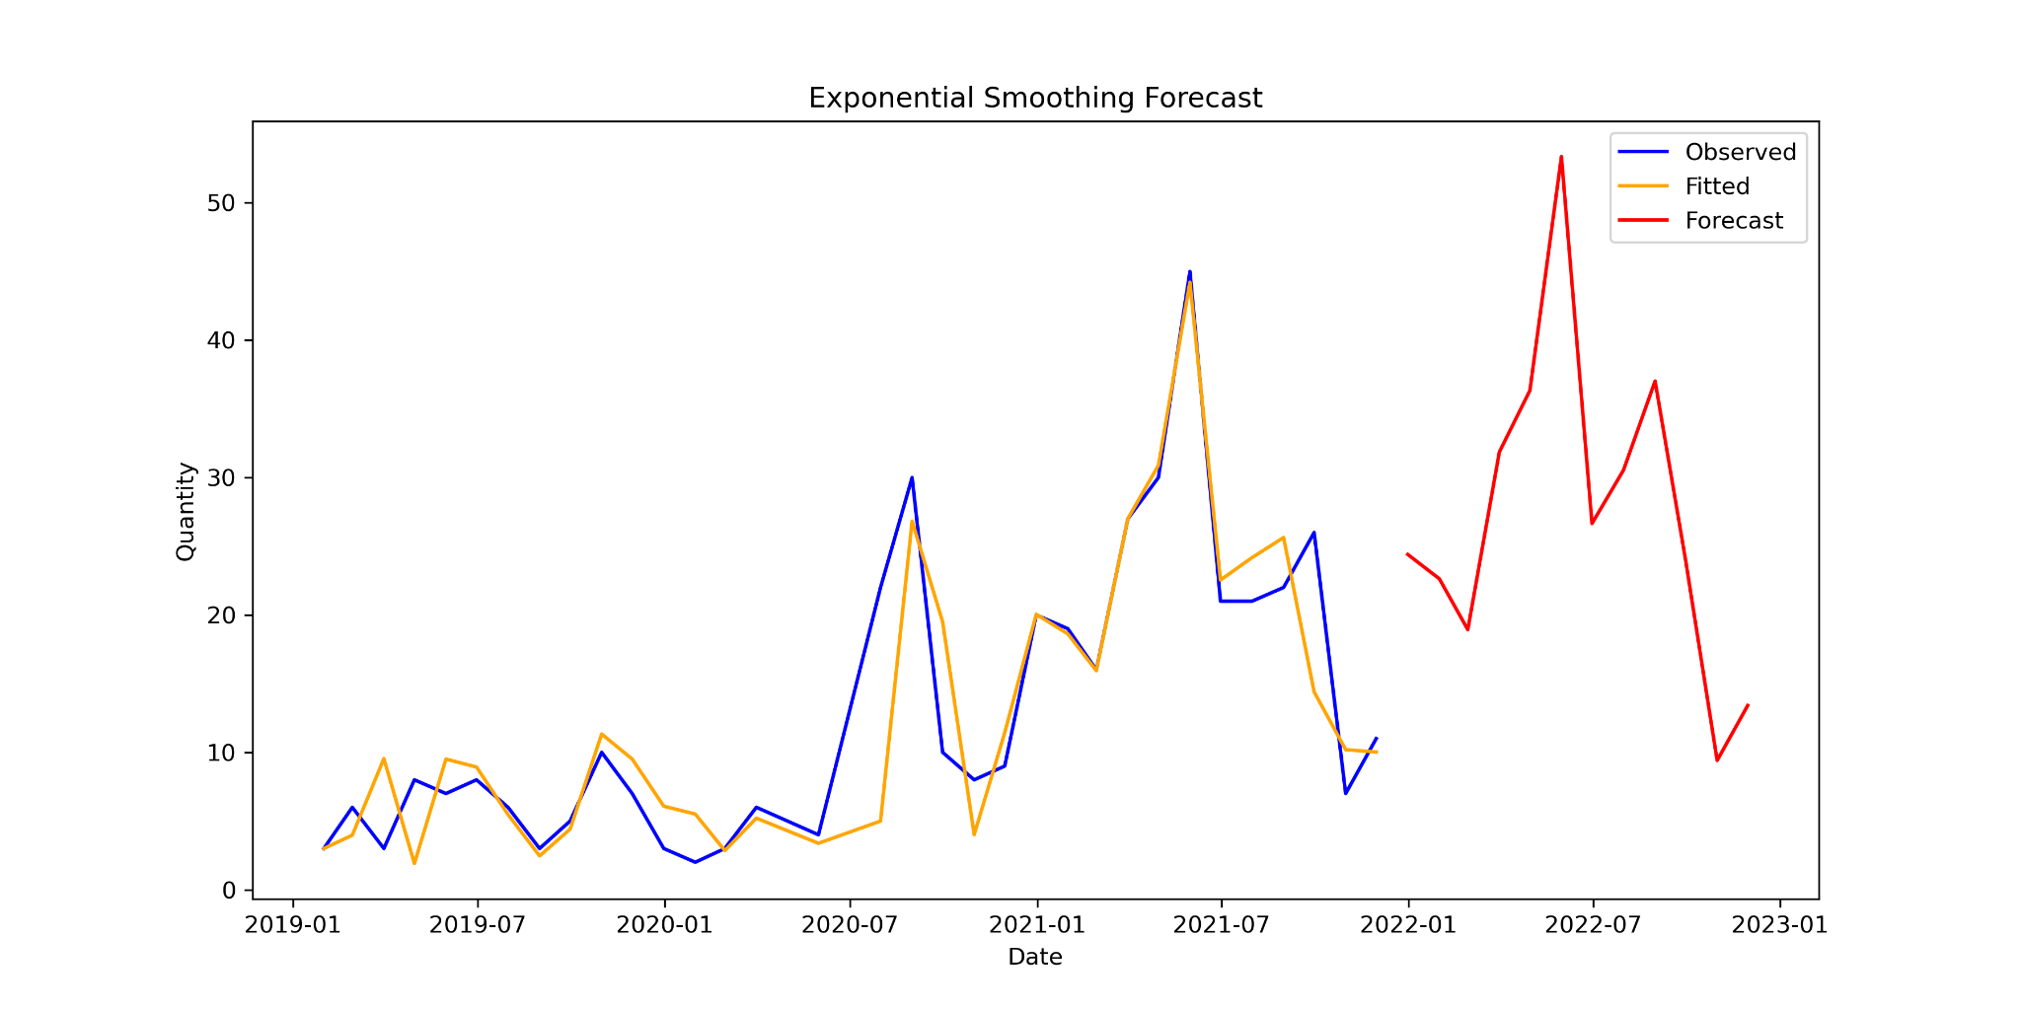
Inventory Management - Results
Mean Absolute Error (MAE): 2.85
On average, each forecast deviates by 2.85 units.
Mean Squared Error (MSE): 21.43

Slide 10
Recommendations
Implement the Product Recommender
Enhance effectiveness by displaying images of recommended items.
Include the store’s stock count in the data.
Prioritize struggling inventory by moving such items to the top of the recommendation list, but use this approach sparingly to avoid overemphasis on slow-selling items.
Incorporate recommender at checkout for online shoppers.
Include the recommender in email marketing campaigns to leverage positive past experiences and boost sales.
Optimize Inventory Management
Order an additional 3 units beyond the forecasted amount due to the model’s relatively low error of about 3 units.
Refine and update the model as more sales data become available to improve accuracy.

Slide 11
Any Questions?
Thank you for the opportunity.

